Slide 1
TDI Capstone Pitch: Cannabis Guide
Jeffrey Kwarsick, PhD
February 2, 2021

Slide 2
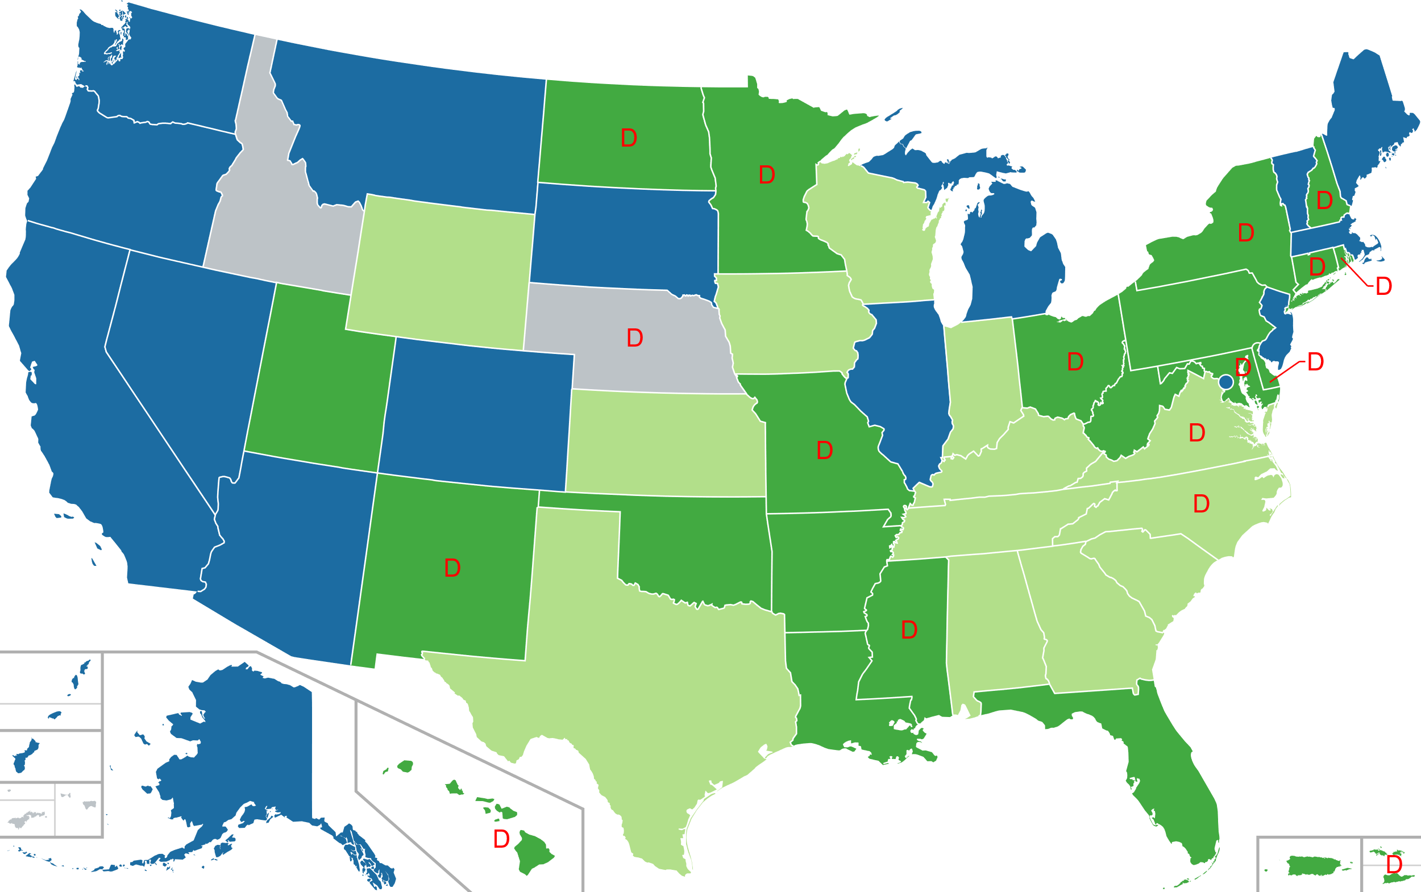
Project Motivation
Legalization of cannabis is continuing to gain steam (Source)
More than half of states have de-criminalized or legalized (Wikipedia)
Medical Use: 35 states
De-criminalized: 16 states
Recreational Use: 15 states + DC
Analytical Tool – Guide
Help entrepreneurs/investors navigate evolution of industry
Understand consumer behavior and interests
Source: Wikipedia

Slide 3
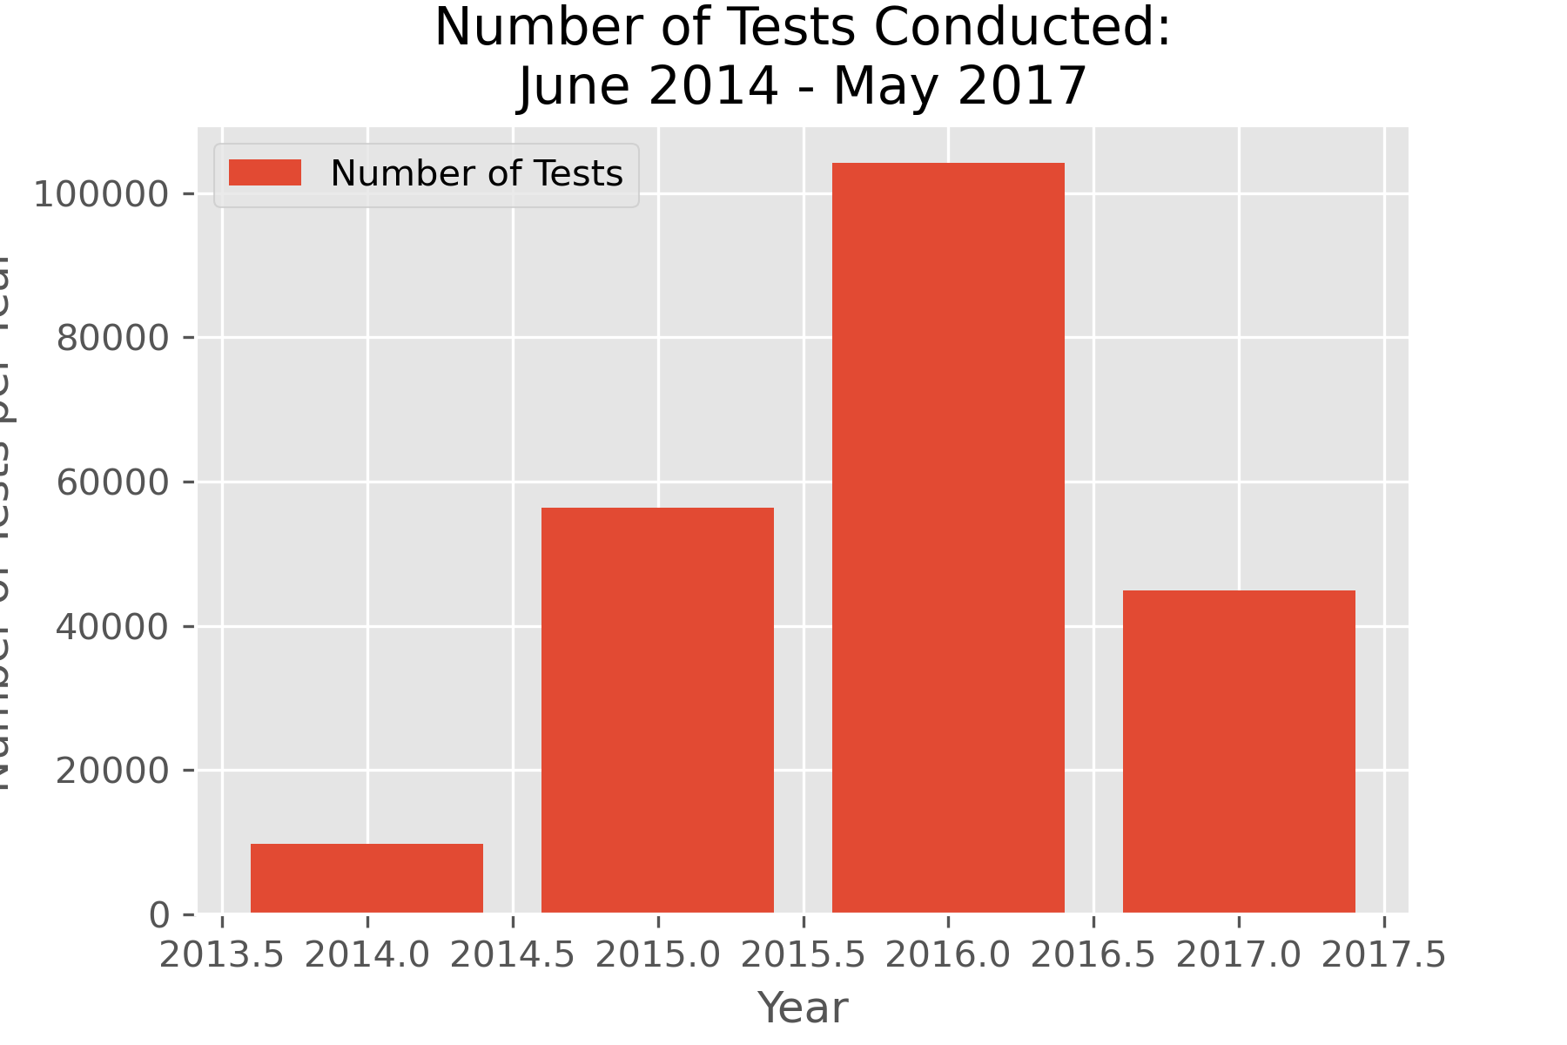
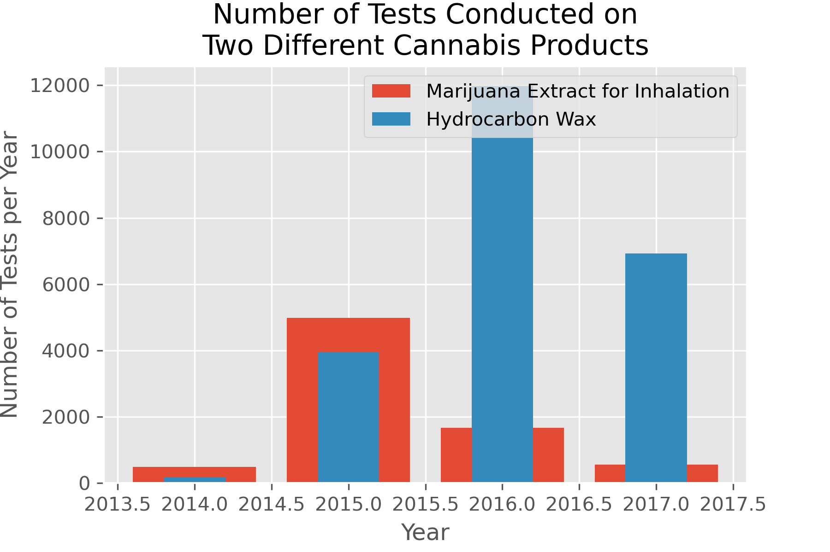
Dataset Background
Cannabis Testing Dataset
State of Washington
2014 - 2017
200k+ samples tested
Grower Info, Testing Lab Info, Product Type, Strain
Web-scraped Strain Information from Leafly.com
Online Database and Learning Resource
Strain description
Positive and negative effects
Observed benefits
Information on 1300+ strains collected

Slide 4
Thank You!

